Slide 1


INSTANT GAJAR HALWA PREMIX
MAKING A RECIPE FOR CONVENIENT GAJAR HALWA
AUGUST 2025
Vigyan Ashram(DIC) Fellow- Aditya Sanjay Dudhane.
Mentor- Mr. Dixit sir & Team Vigyan Ashram.

Slide 2

INTRODUCTION
I joined Vigyan Ashram to learn practical skills, explore food product development, and work on innovative ideas that can solve real-life problems.
During my training, I identified the need for convenient traditional foods. Gajar Halwa, though loved by everyone, is time-consuming to prepare, seasonal, and has a short shelf life.
This inspired me to develop an Instant Gajar Halwa Premix—a product that saves time, is easy to prepare, and preserves authentic taste.

Slide 3

PROBLEM STATEMENT
Traditional Gajar Halwa preparation is time-consuming, labor-intensive, and requires skilled cooking.
Cooked halwa has a short shelf life due to high moisture and dairy content.
Quality is inconsistent when purchased from shops or restaurants (variation in taste, texture, hygiene).
Storage and transport are difficult – refrigeration required, leading to spoilage and wastage.
Need for a convenient, shelf-stable, preservative-free solution that delivers authentic taste, consistent quality, and longer shelf life.

Slide 4
OBJECTIVES
To develop a ready-to-cook Gajar Halwa premix with authentic taste and aroma.
To optimize ingredient composition for better texture, flavor, and nutrition.
To study suitable drying and packaging methods for longer shelf life.
To evaluate the cost-effectiveness and market potential of the product.
To provide a convenient, quick, and hygienic alternative to traditional preparation.
1
2
3
4
5

Slide 5
MATERIAL REQUIREMENTS
Core Ingredient (base) | Fresh Carrots (main raw material)
Dairy Component | Milk Ghee
Sweetener | Fructose (in the carrot)
Flavoring & Enhancers | Cardamom Powder Nuts & Dry Fruits (cashew, almond, raisins – optional)
Packaging Material | Laminated Pouches Zip-lock

Slide 6
METHODOLOGY
1
Washing | Fresh carrots thoroughly cleaned to remove dirt and impurities.
Blanching Carrots | Blanched at 101°C on high flame to inactivate enzymes, cooking(1hrs) and preserve color.
Grating / Slicing | Manual or mechanical slicer for large batches(0.5cm).
Initial Drying | Dry at 55°C for ~5 hours in an electric dryer until moisture is reduced.
Milk Reduction & Mixing (45min) | Reduce milk to simulate mawa consistency.
Add dried carrots, ghee, flavoring, and enhancers | Ratio: 100 g dried carrot : 600 ml milk, 16ml Ghee,16gm Dry fruits, 2gm Cardamom Powder
Final Drying | Dry mixture again at 55°C for ~6 hours to get stable premix (Also phase 01&02).
Packaging | Pack in stand-up pouches. Attach labels with product info & cooking instructions.
2
3
4
5
6
7
8

Slide 7
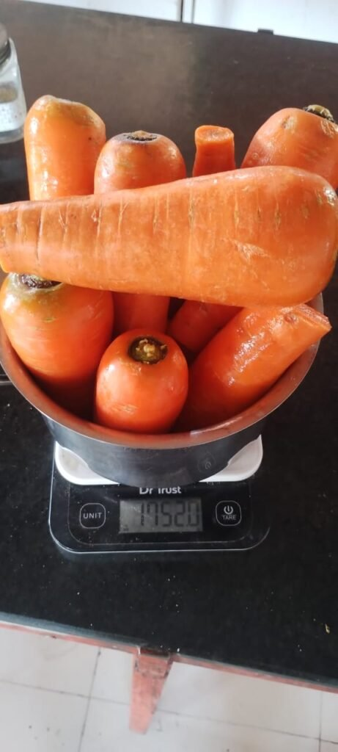
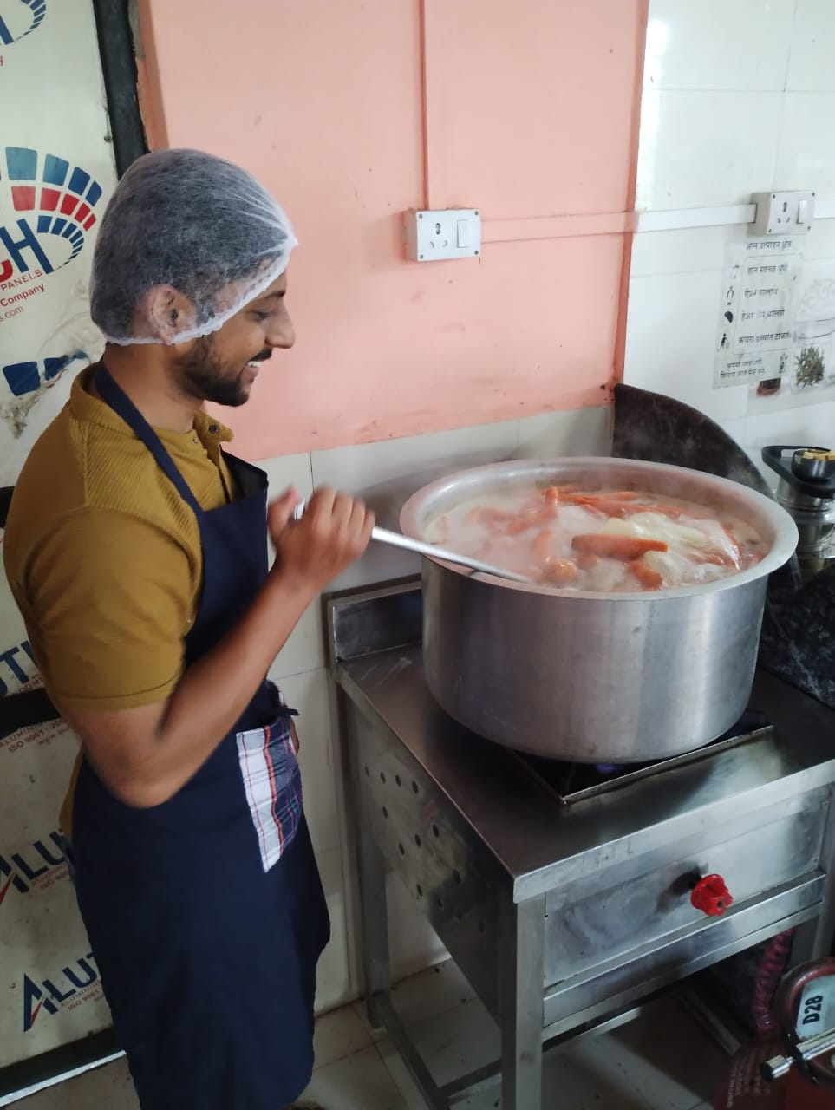
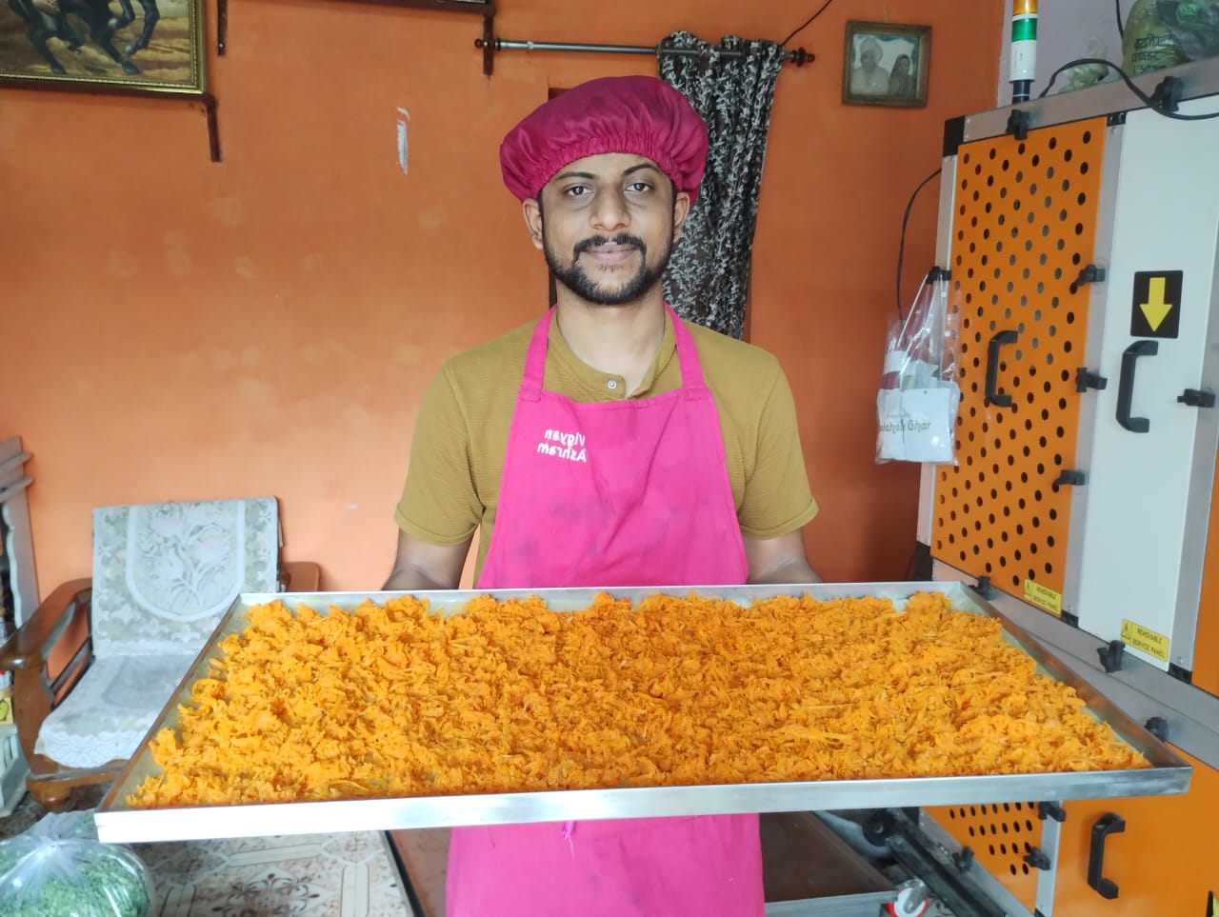
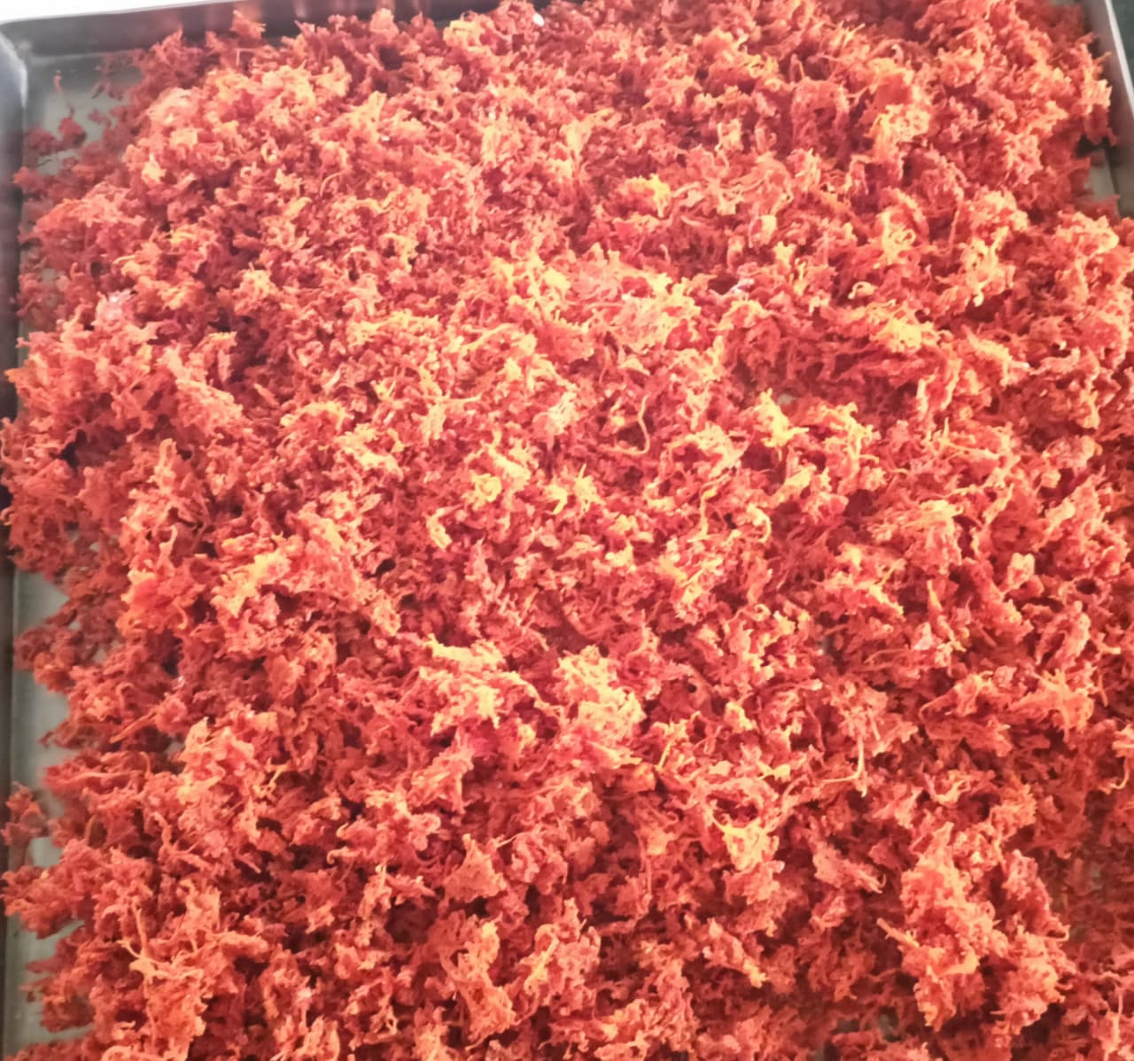


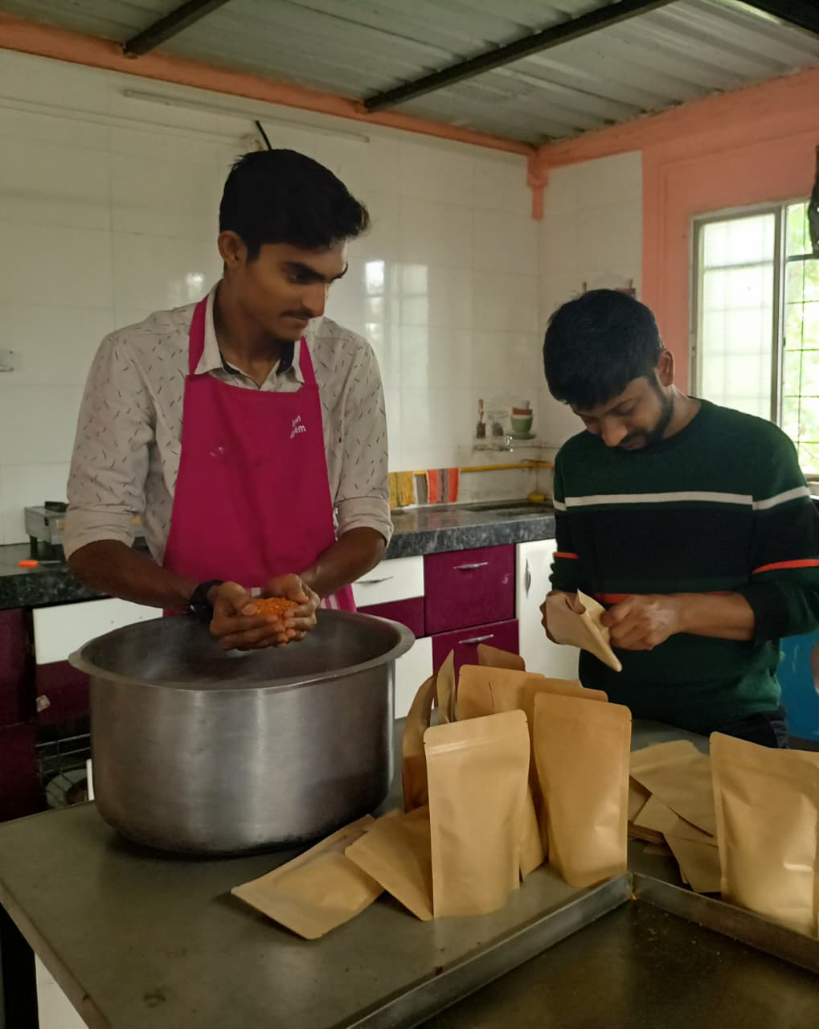
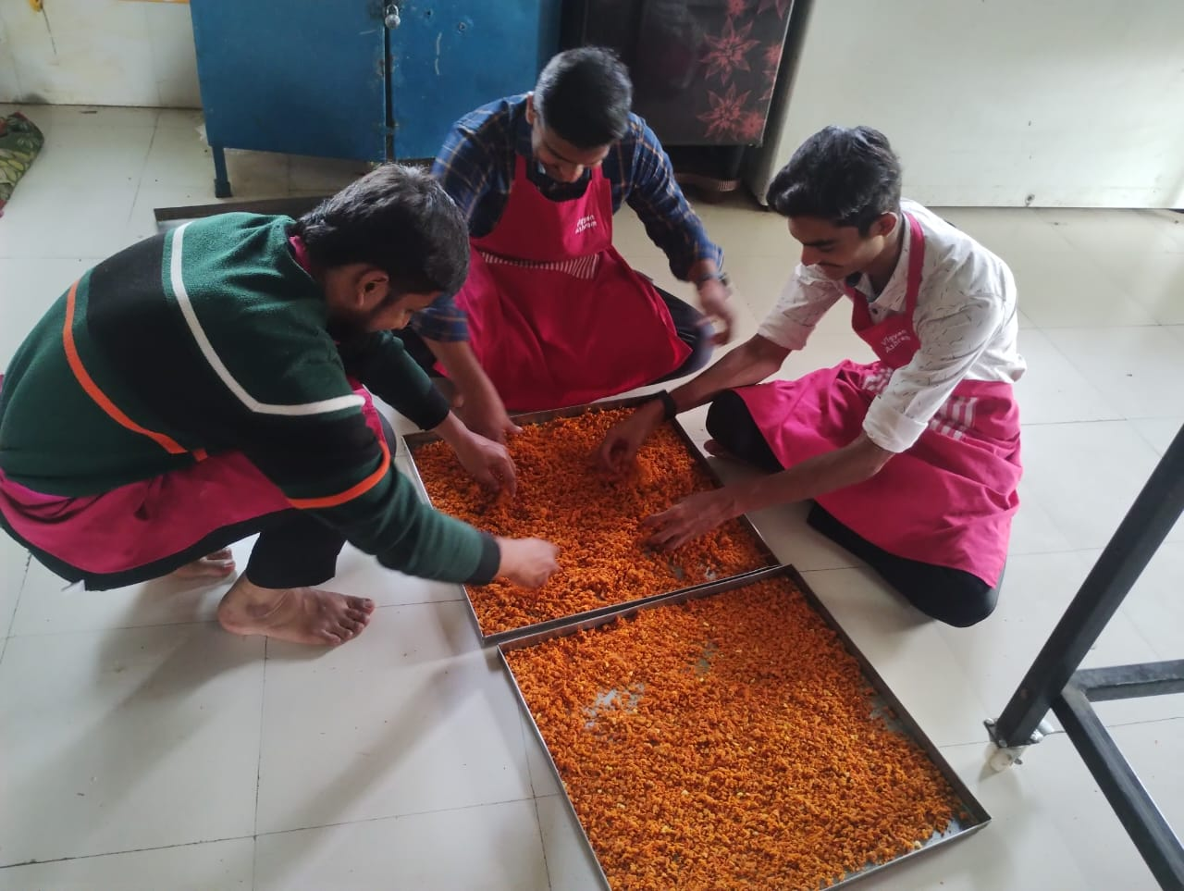
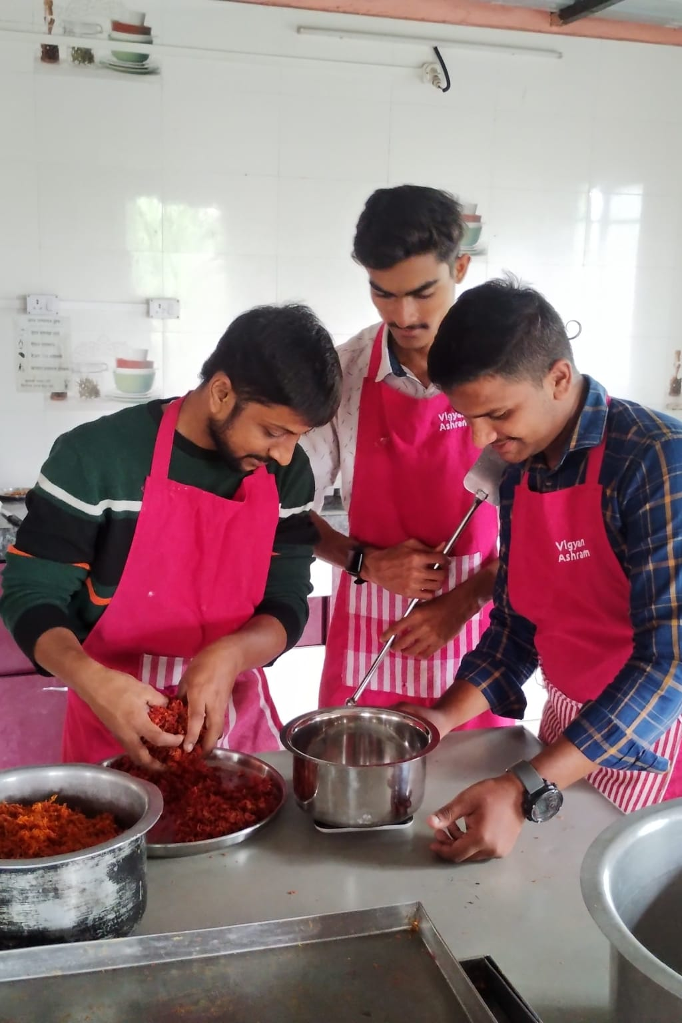
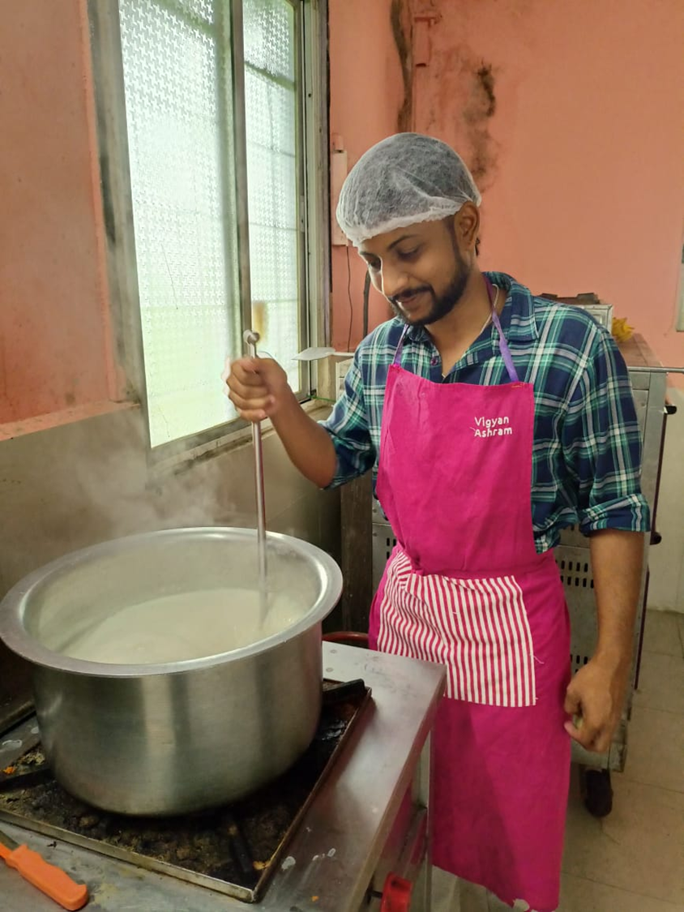
PROCESS PHOTOGRAPHS

Slide 8
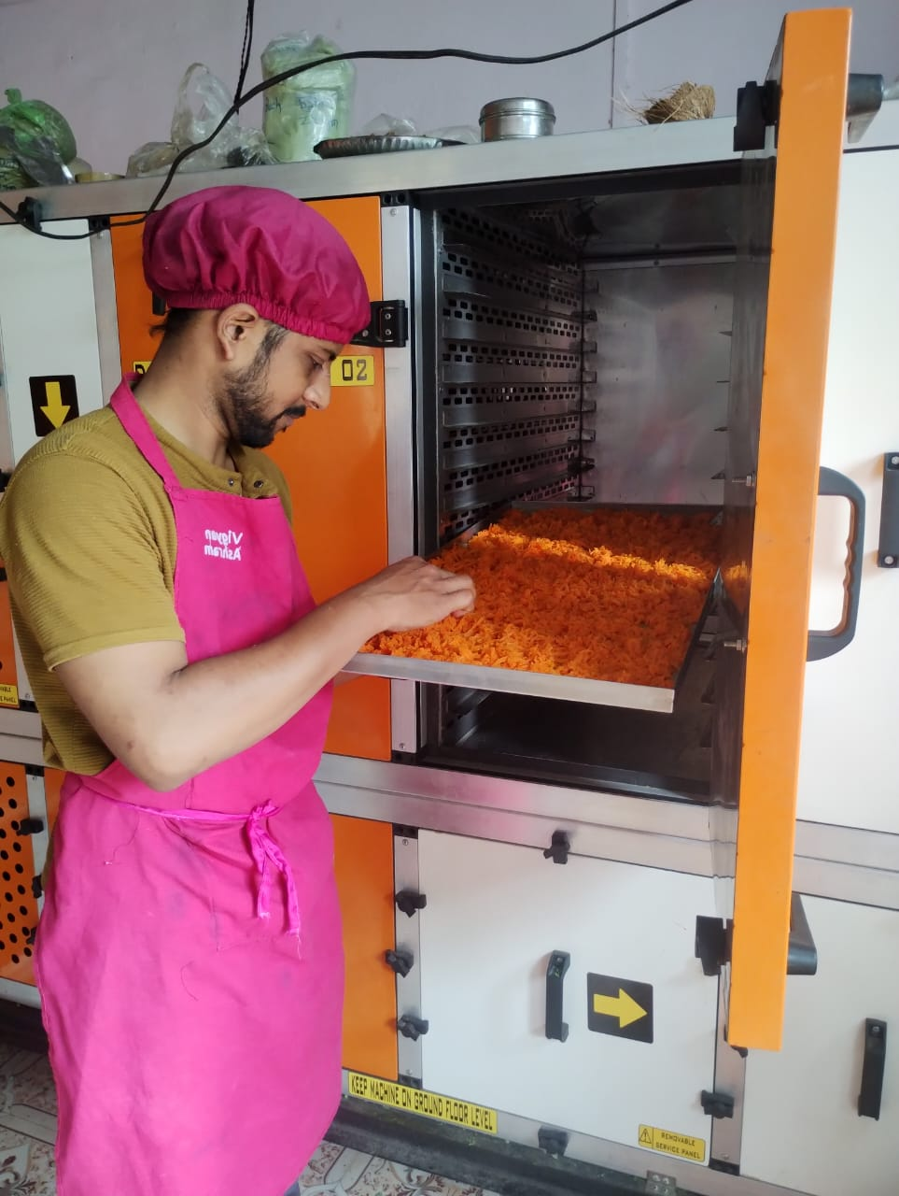
TRIALS CONDUCTED
Sugar vs Jaggery trials
Carrot Cooking (Process Control)
Moisture loss (LOD) calculation
Drying rate & energy consumption
Taste, texture & aroma evaluation
Shelf-life under observation

Slide 9
RESULTS
Product Quality | Authentic taste, aroma, and texture similar to fresh halwa. Good rehydration capacity when cooked with milk. Colour retention (natural orange) due to blanching.
Sensory Evaluation | Overall Acceptability: Very Good Taste: 8/9 Aroma: 8/9 Texture: 7.5/9
Shelf Life | Stable for 30–45 days in laminated standy pouches at room temperature. No microbial growth or rancidity observed in storage period.
Cost Analysis | Cost of production (per 100 g premix): ~₹75 Market price potential: Higher than cost.
Link to the SOP file for this project: Click here

Slide 10
COSTING
Item / Ingredient | Weight (grams) | Cost (₹)
Carrot | 54g | ₹17(22.66%)
Milk | 20g | ₹20(26.66%)
Ghee | 15g | ₹11(14.66%)
Elaichi | 2g | ₹8(10.66%)
Dry fruits | 9g | ₹9(12%)
Packaging & labelling | -- | ₹10(13.33%)
Total | 100g | ₹75

Slide 11
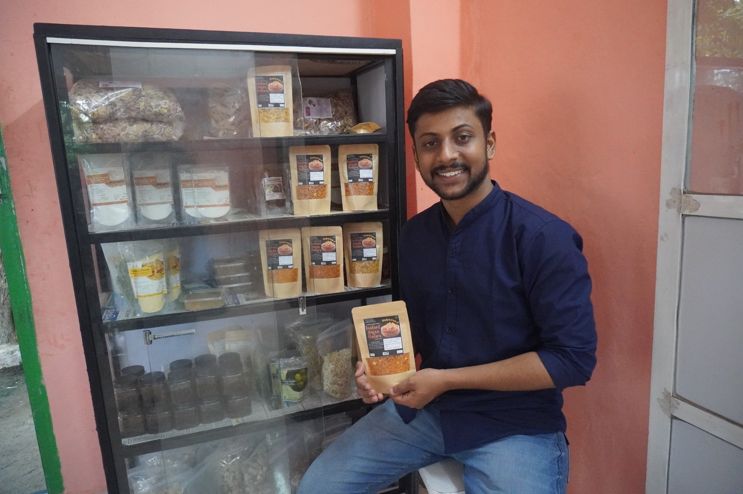
OBSERVATIONS
Drying at 55°C preserved β-carotene better.
Adding ghee during mixing improved flavour but slightly reduced shelf stability.
Packaging in laminated pouches maintained crispness and prevented moisture absorption.

Slide 12
CUSTOMER FEEDBACK
Positive
Constructive
Taste is very authentic and traditional
Product is easy and quick to make / serve
Customers appreciated no added preservative use and fully natural ingredients
It’s very unique product (It is not costly because it contain around 540gm raw Gajar)
The texture and aroma of the Instant Halwa is like moderately
Product at ₹75 was costly for some customers
Some hard pieces caused from granule particles not able able to rehydrate
Level of ideal sweetness varies by customer preference
Feedback collected from customers who purchased product in Vigyan Ashram exhibition

Slide 13

NUTRITIONAL VALUE CHART
Nutrient | %Value
Energy | 15%
Carbohydrate | 13%
Dietary Fiber | 10%
Protein | 12%
Fat | 18%
Saturated Fat | 6%
Cholesterol | 8%
Calcium | 10%
Iron | 6%
Vitamin A | 12%
Sodium | 8%

Slide 14
MARKET POTENTIAL
The Indian ready-to-mix food market is growing rapidly at 15% CAGR, projected to cross USD 1 billion by 2029.
Dessert mixes are one of the fastest-growing segments, driven by demand for quick, authentic, and festive sweets.
With the rise of e-commerce and modern retail, instant products are reaching wider consumers.
Few options exist for traditional desserts like Gajar Halwa, creating a strong niche opportunity.
Positioning the product as authentic, convenient, and natural can capture both urban and festive markets.

Slide 15
CHALLENGES
Cooking Process Control | Maintaining uniform cooking and establishing a standardized process for how the carrots are cooked.
Moisture Control | Incomplete drying causes spoilage and reduces shelf-life.
Scaling Up | Moving from small trials to large-scale production requires advanced equipment and higher cost.
Taste & Aroma | Hard to retain authentic halwa flavors after dehydration.
Shelf-life | Still under study; airtight packaging and preservatives may be required

Slide 16
FUTURE SCOPE
Shelf-life Improvement | Natural preservatives & advanced packaging
Better Drying Methods | Vacuum drying / Freeze drying for quality / Heat Pump dryer
Commercial Production | Scaling up for large-scale manufacturing
Product Diversification | Develop other Indian sweet premixes

Slide 17
CONCLUSION
The Instant Gajar Halwa Premix project successfully demonstrates how a traditional Indian sweet can be transformed into a convenient, ready-to-use product without losing its authentic taste.
By standardizing the cooking and drying process, controlling moisture, and optimizing ingredients, the premix offers longer shelf-life, easy preparation, and strong market potential.
This innovation not only saves time for consumers but also creates opportunities for commercialization in the growing instant food industry.

Slide 18
REFERENCES
Market Insights Research (2023). India Ready-to-Mix Food Industry Report.
Food Safety and Standards Authority of India (FSSAI). Guidelines for Food Premix and Shelf-life Standards.
Vigyan Ashram Blog & Project Documentation (2025). Development of Instant Gajar Halwa Premix.

Slide 19
THANK YOU
Prepared by Vigyan Ashram

