Slide 1
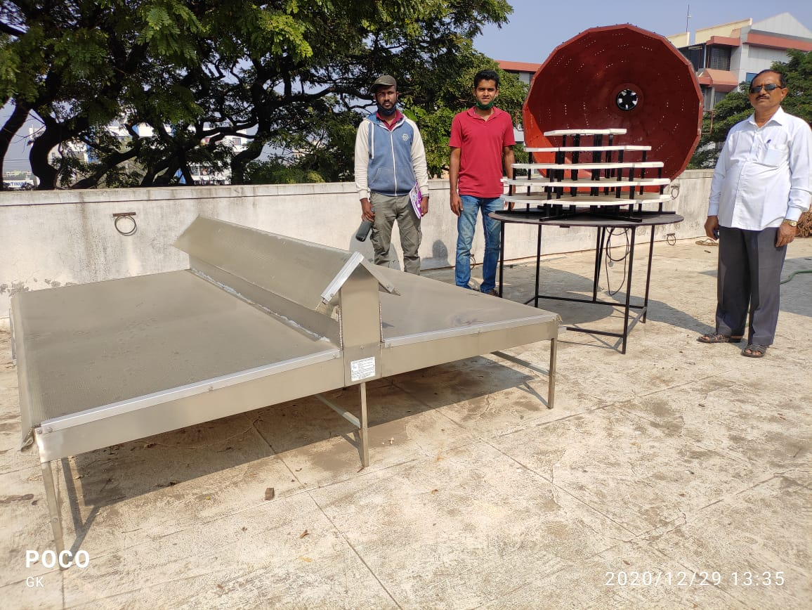

Slide 2
Parameter | Dome dryer | S4S dryer | Remark
Area occupied by the dryer | 1.16 m² | 4.23 m² | 3.64 times less area
Area exposed to sunlight | 2.33m² | 3.86m² | 1.65 times less
Area exposed per unit area occupied | 2 | 0.91 | 2.19 times more.
S.A. of trays | 2.5m² | 4m² | 1.6 times less
Total cost | 25000 Rs | 35000 Rs | 1.4 times less
Cost per square meter | 10000 Rs | 8750 Rs | 1.15 times more

